Slide 1
Luxury Beauty
Products Sentiment Analysis
Data Science for Product Managers,Spring 2021
Ajay Valecha, Akshay Oza, Anmol Kapoor

Slide 2
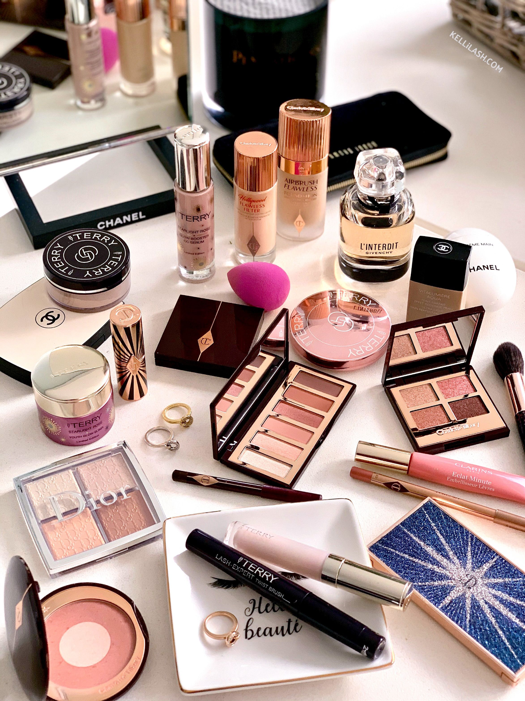
$126 Billion
$18.8 Billion
Global Luxury Beauty Products Market
United States Beauty Products Market
Source: Statistica
Notes:
Amazon Launched Luxury Beauty in October 2013 to create a platform for selling high end skin care, makeup,fragrance etc. for brands only with invitation and today more than 30,000 different beauty products are sold

Slide 3
Approach
01
03
02
04
Defining Problem and Business/Research Questions
Unsupervised Sentiment Analysis Models
Exploratory Data Analysis
Model Evaluation and Future Scope

Slide 4
01
Problem Definition

Slide 5
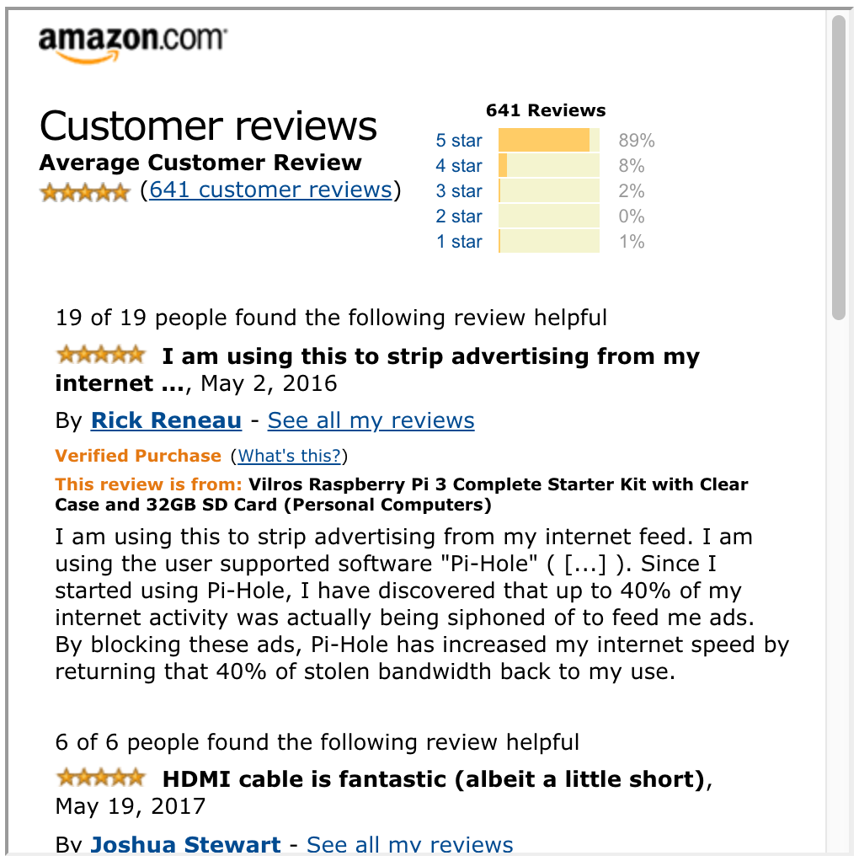
Problem and Questions
Sentiment Analysis is a powerful tool but with reviews the label for sentiment is always not present.
Businesses want different approaches to get the sentiment out of the customer reviews

Slide 6
Business Questions
Is there a correlation between the price, number of reviews, etc and the overall average rating a product gets?
What are some different models businesses can use to perform unsupervised sentiment analysis and how well do they perform?

Slide 7
02
Exploratory Data Analysis

Slide 8
Amazon Reviews Data
We retrieved data from Stanford University’s Data Repository. Data was in json.gz format
There were a total of 0.5 million records for more than 2000 luxury beauty products
After cleaning and preprocessing we chose top 35 products with more than 3000 reviews

Slide 9
Amazon Reviews Data
Reviews Data:
-reviewer_id
- asin
-review.text
- overall
- vote, etc.
Meta Data:
- asin
- title
- description
-similar, etc.

Slide 10
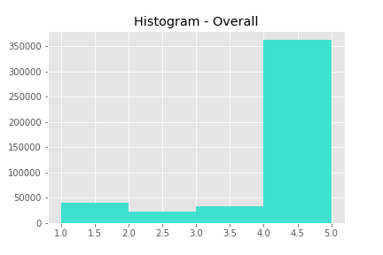
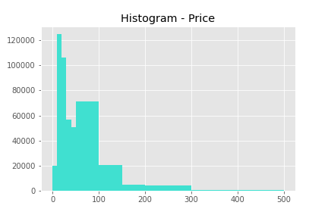
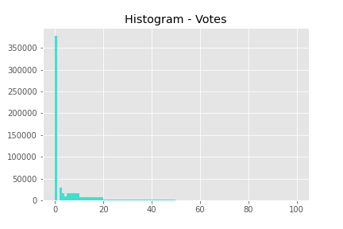
EDA I

Slide 11
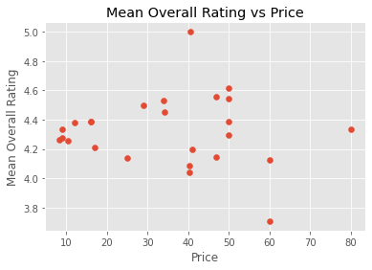
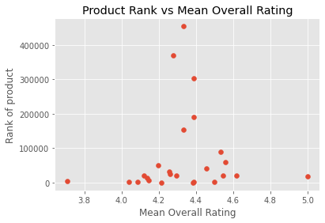
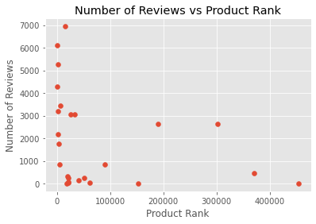
EDA II- Scatter Plots

Slide 12
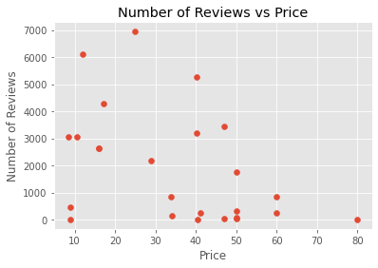
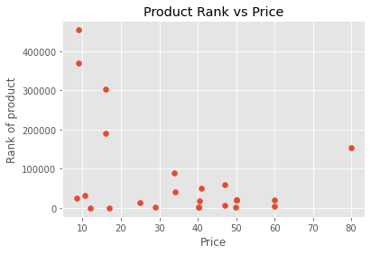
EDA II- Scatter Plots
Non Linear Relationship

Slide 13
03
Unsupervised Sentiment Analysis

Slide 14
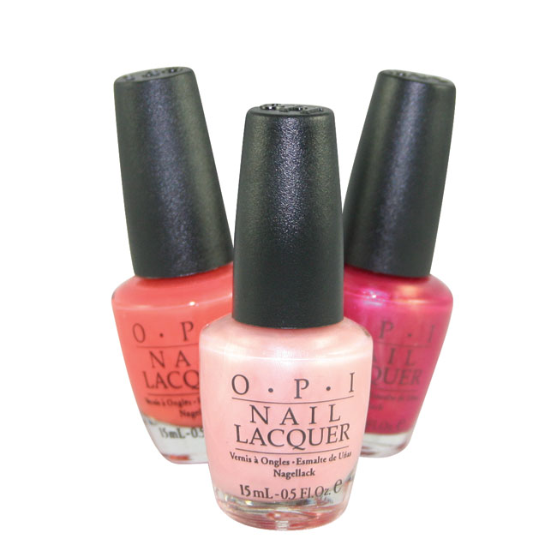
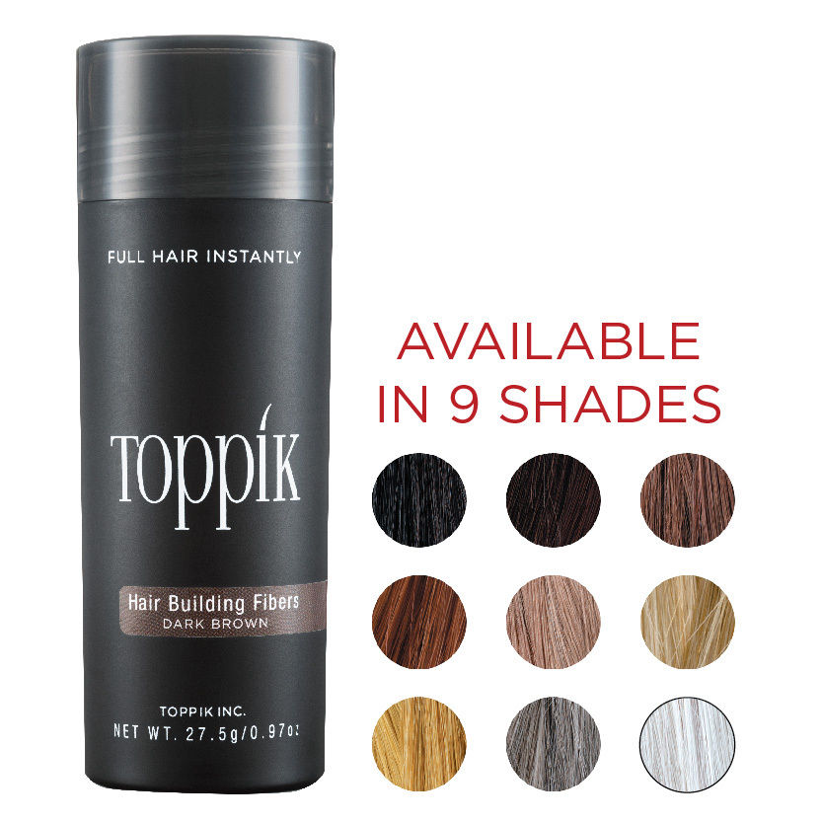
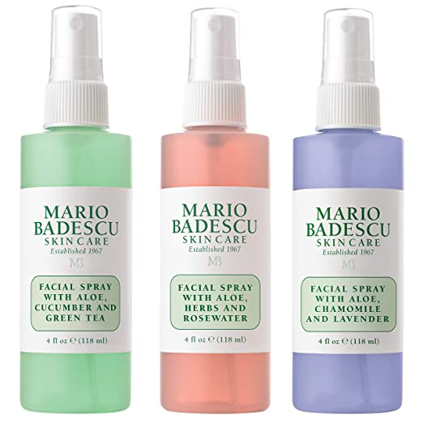
3 Products
O.P.I Nail Lacquer
TOPPIK Hair Building Fiber
Mario Badescu Facial Spray
3000+ Reviews
11000+ Reviews
6100+ Reviews

Slide 15
3 Models
1
2
3
VADER from NLTK
K-Means Clustering with Word2Vec Model
K-Means Clustering with Self Organizing Maps (Neural Networks)

Slide 16
Text Preparation for Modeling
Remove all stop words specific to the product which are very frequent or dominantly appear in the product description
Tokenizer emphasized Nouns, Adjectives and Verbs
For example :
For Mario Badescu Facial Spray we removed words like “mario”, “badescu”, “facial”, “spray”, “mist”, “liquid”, ”skin”, “product”,”products”

Slide 17
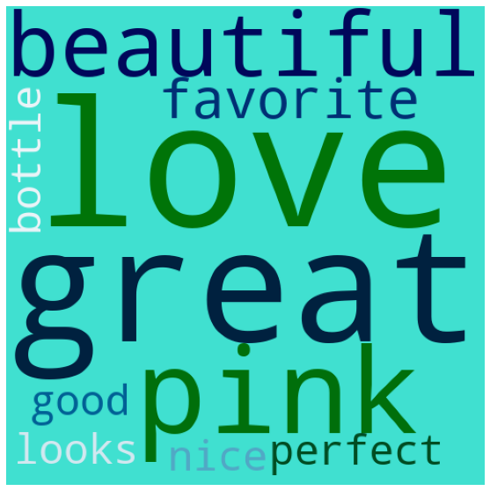
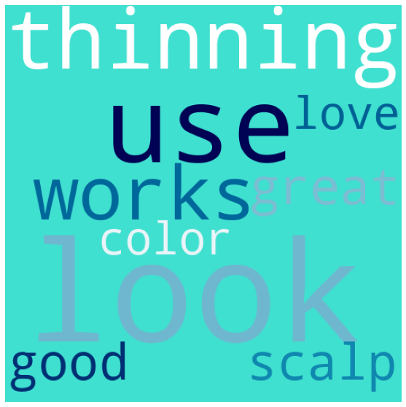
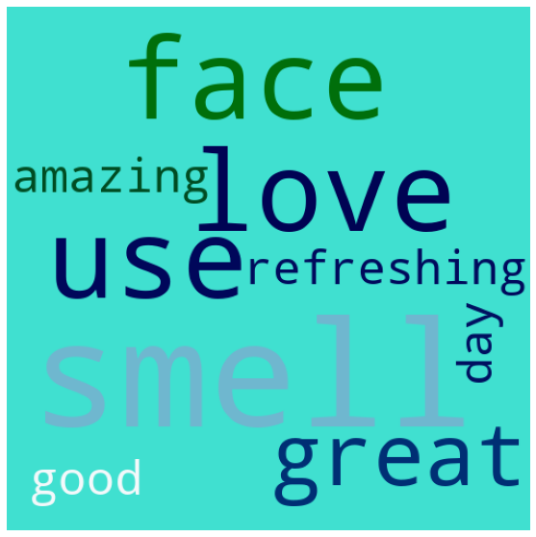
Top Words
Product 1: O.P.I Nail Lacquer
Product 2: TOPPIK Hair Building Fiber
Product 3: Mario Badescu Facial Spray

Slide 18
VADER Sentiment Analysis
VADER (Valence Aware Dictionary and sEntiment Reasoner) is a lexicon and rule-based sentiment analysis tool that is specifically attuned to sentiments expressed in social media.
SentimentIntensityAnalyzer() is an object and polarity_scores is a method which will give us scores of the following categories:
· Positive
· Negative
· Neutral
· Compound
The compound score is the sum of positive, negative & neutral scores which is then normalized between -1(most extreme negative) and +1 (most extreme positive).
The more Compound score closer to +1, the higher the positivity of the text.

Slide 19
VADER Sentiment Analysis
Advantages
It does not require any training data
It can very well understand the sentiment of a text containing emoticons, slangs, conjunctions, capital words, punctuations and much more
It works excellent on social media text
VADER can work with multiple domains

Slide 20
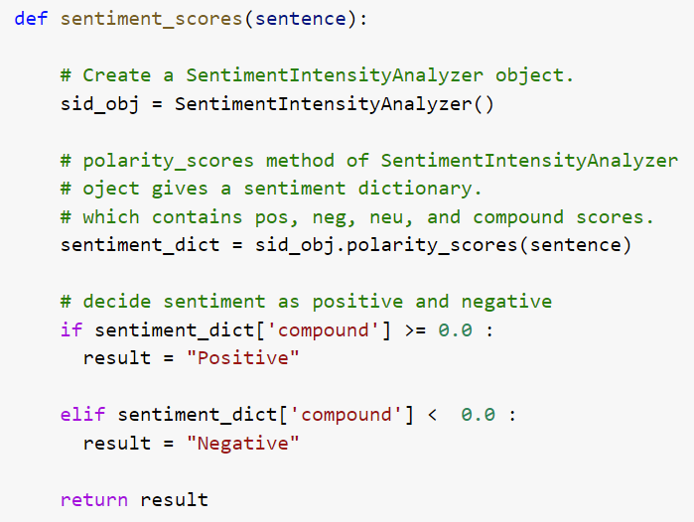

Slide 21
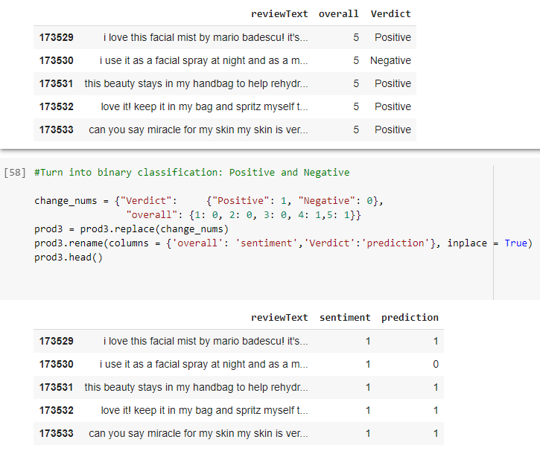

Slide 22
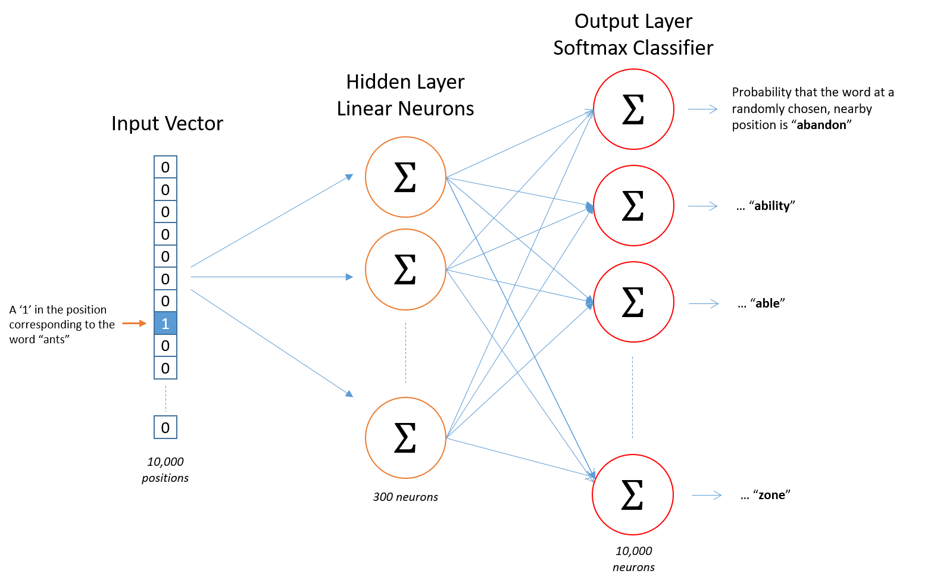
K- Means with Word2Vec Model
Word2Vec from gensim
Uses a Neural Network model to learn association between words . Can either be trained from the data by creating a vocabulary or by using the pre-trained corpus
Source: Towards Data Science

Slide 23
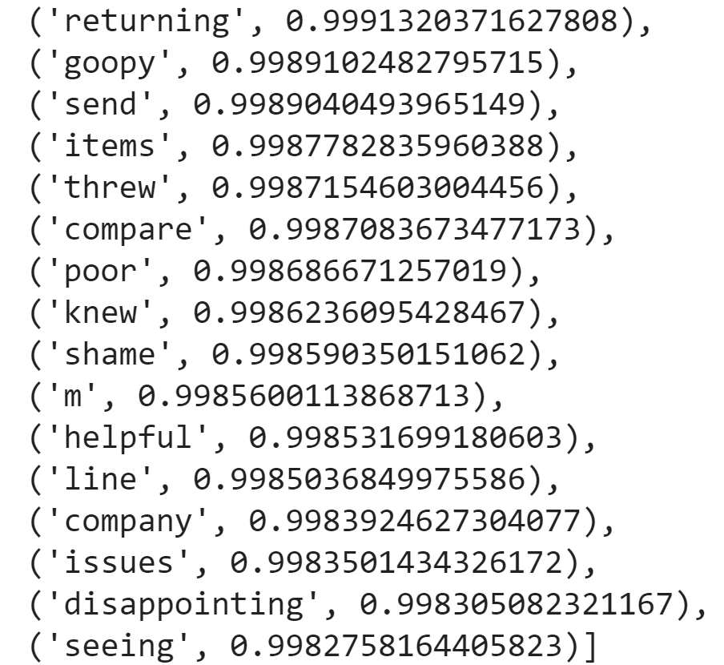
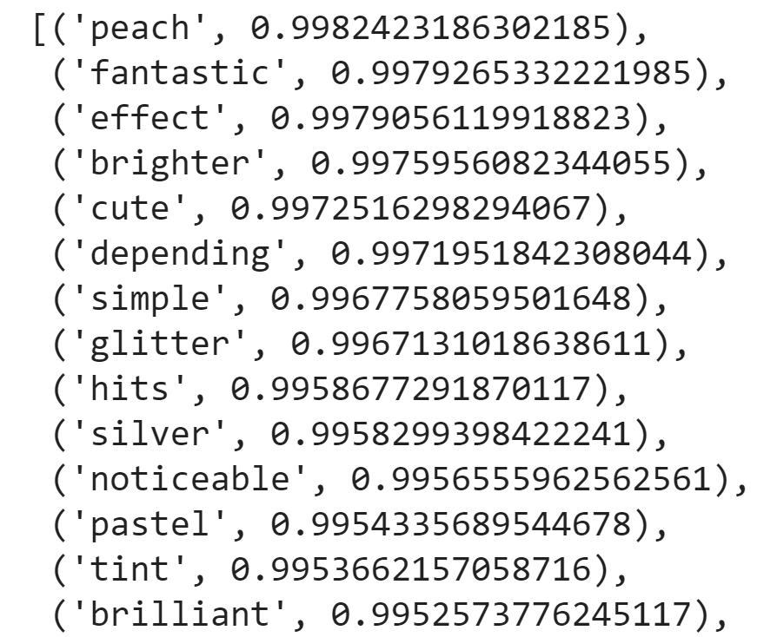
K- Means with Word2Vec Model
Created a Word2Vec Model and Vocabulary for each product
Using the Word2Vec Vectors created 2 clusters - one for positive and one for negative

Slide 24
K- Means with Word2Vec Model
Created a Sentiment Dictionary that maps the sentiment from clustering and closeness score (1/min[vector]) for each model
Create a TF-IDF Vectorizer with a custom tokenizer and map the weights to the reviews.
Each review than was converted into a vector of Sentiment Coefficients and TF-IDF Vectors

Slide 25
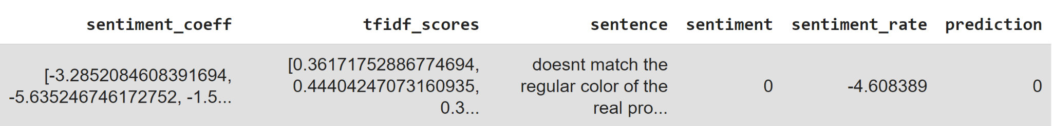
K- Means with Word2Vec Model
Dot Product of Sentiment Coefficients and TF-IDF Vectors
If the dot product was positive the prediction was 1 (positive) or 0(negative)
For example:

Slide 26
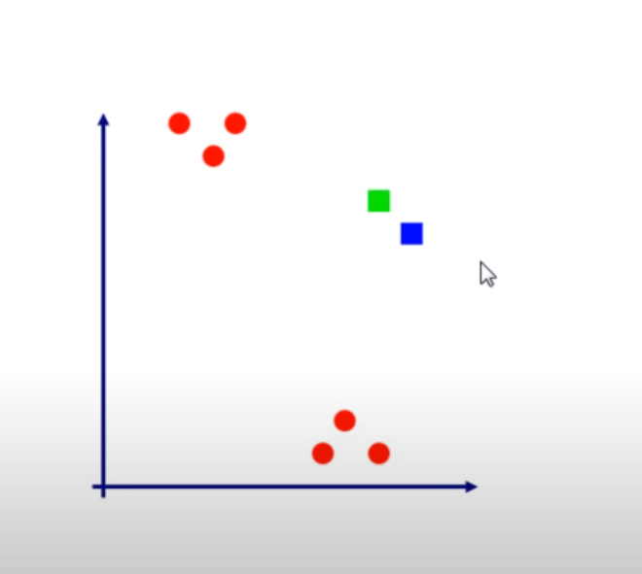
K- Means with SOM
Self Organizing Maps are Unsupervised Clustering Neural Network model
Process:
Initialize Weights
Random Data Point
Euclidean Distance
Update Weights
Repeat

Slide 27
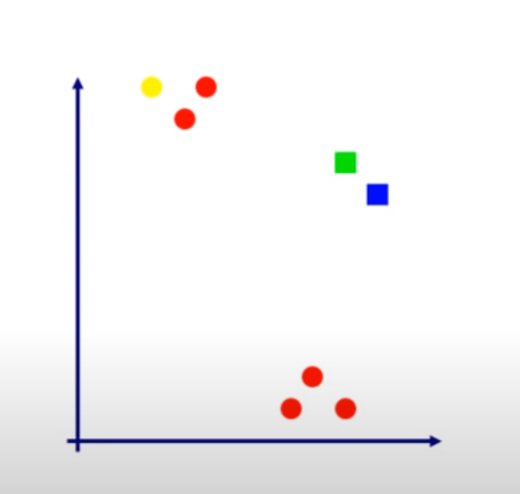
K- Means with SOM
Self Organizing Maps are Unsupervised Clustering Neural Network model
Process:
Initialize Weights
Random Data Point
Euclidean Distance
Update Weights
Repeat

Slide 28
K- Means with SOM
Create a TF -IDF vectorizer and truncate the vectors
Use SimpSOM package in Python to create a Self Organizing model
Created and Trained a 20x20 Node Network (default and most commonly used value)

Slide 29
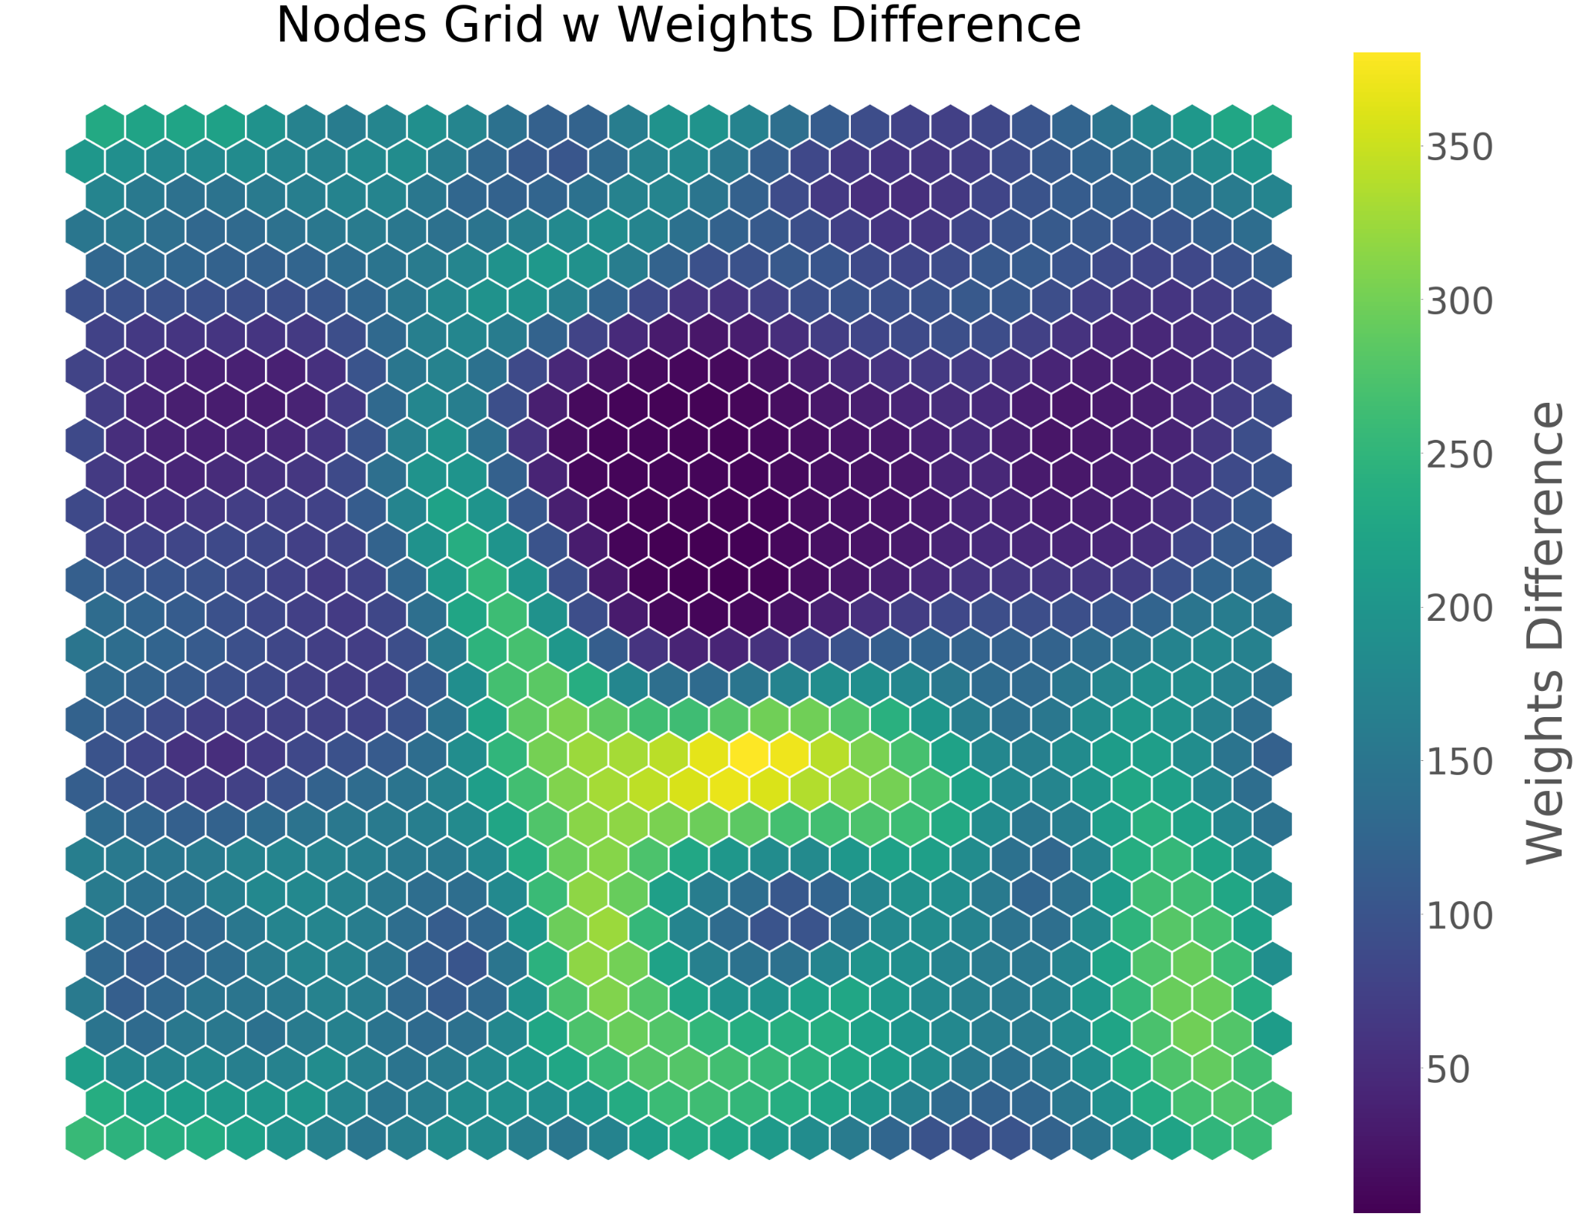
K- Means with SOM

Slide 30
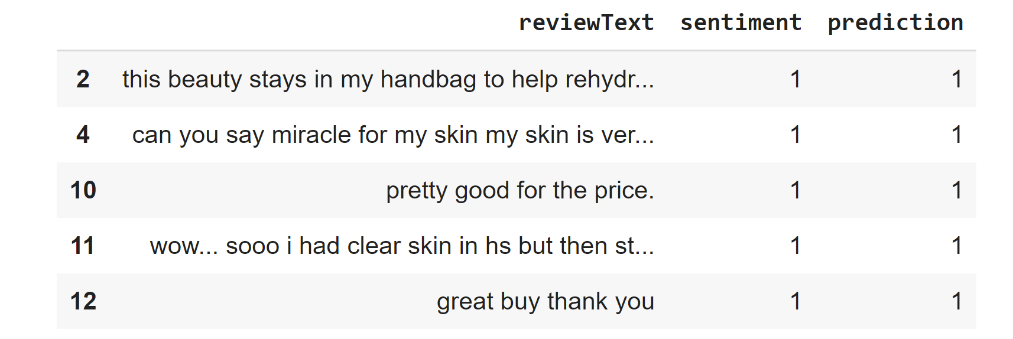
K- Means with SOM
We then clustered it using K-Means and compared the sentiment and prediction

Slide 31
04
Model Evaluation and Recommendations

Slide 32
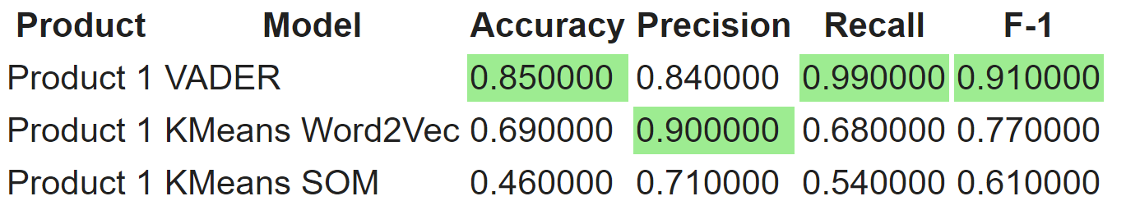
Model Evaluation: Product 1

Slide 33
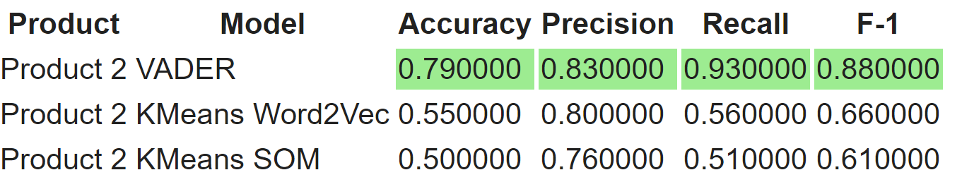
Model Evaluation: Product 2

Slide 34
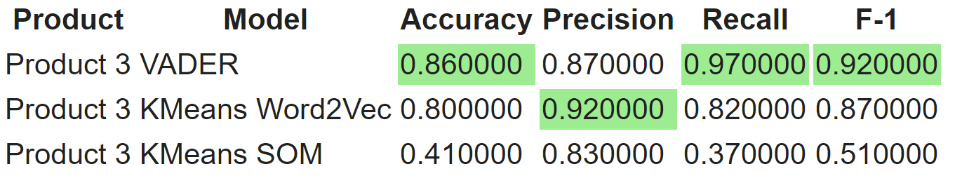
Model Evaluation: Product 3

Slide 35
Recommendation and Future Steps
If the decision makers care about recall and F-1 Score, VADER is a good model. If they care about Precision alone, they can use K-Means with Word2Vec
The models we used are not very optimized. Especially SOM which requires more data as well as computationally faster infrastructure. We can fine-tune them to create as good results as VADER.
More expertise from Beauty Product experts can help us decide more ways to prepare the text and remove/modify tokens accordingly

Slide 36
Questions?

